Slide 1

Redis
The In-Memory Datastore Powering Transactional E-Commerece
Rishin Tiwari (U00029780)
[University of South Florida, Tampa]
[Advanced Database Management]
[08-11-2023]

Slide 2
Redis Overview
(Re)mote (Di)ctionary (S)erver
Redis is an open-source, in-memory data store (low latency).
It's known for its blazing-fast data retrieval and stores data as key-value pairs.
NoSQL Database, It’s schema-less, allowing flexibility in data structures.
Used for caching, real-time analytics, pub/sub, and more.
Has a user-friendly Command-Line Interface (CLI) for interaction.
Ideal for accelerating web applications and managing real-time data.
A go-to solution for enhancing performance in modern applications.
Trusted by major companies like Twitter, Pinterest, AirBnB and GitHub.

Slide 3
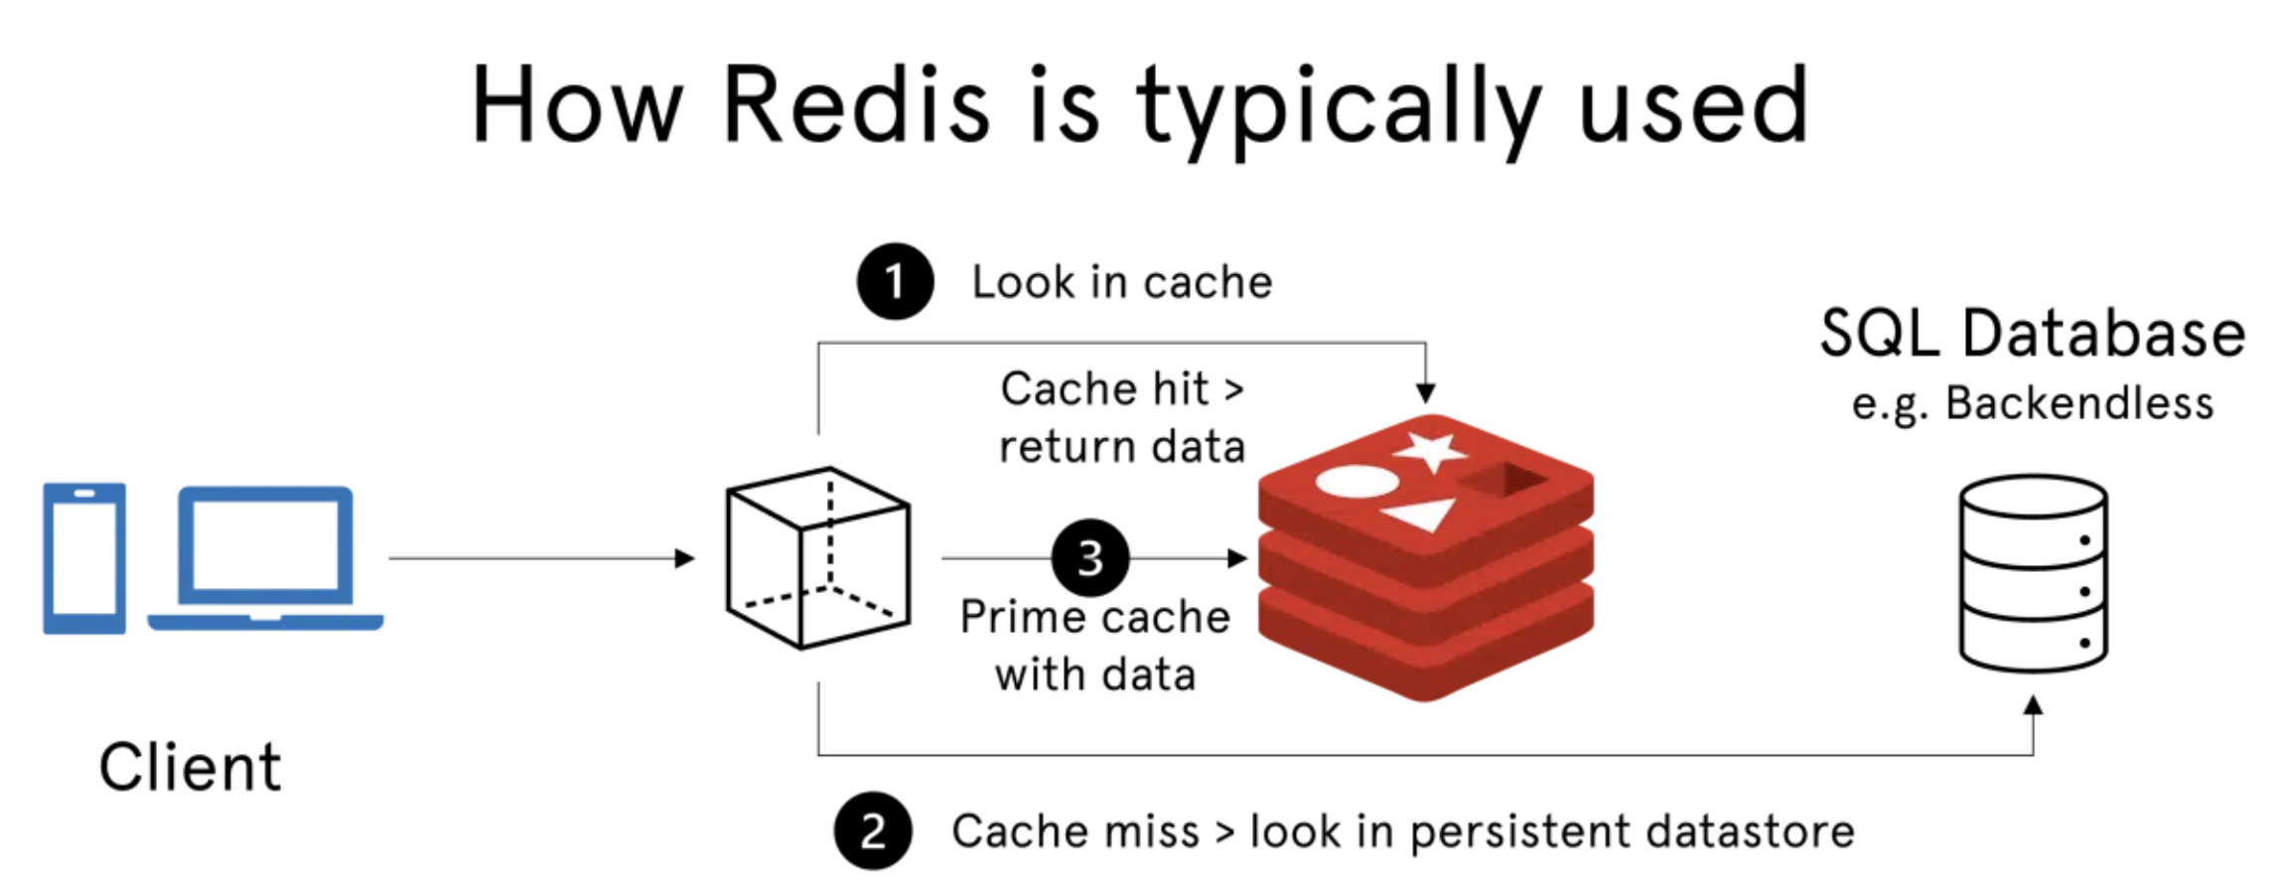
Redis Working
In-Memory Storage: Redis stores data in RAM, providing rapid data access.
Key-Value Storage: Data is stored in key-value pairs, offering simplicity and efficiency.
Persistence Options: Redis offers options for data persistence to protect against data loss.
Event-Driven: Redis is event-driven, handling real-time data and enabling pub/sub messaging.

Slide 4
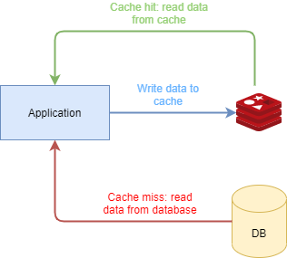
How Redis is Different from Traditional Database
In-Memory Storage: Redis stores data in RAM, allowing lightning-fast data retrieval, while traditional databases rely on disk storage, resulting in slower access times.
Key-Value Structure: Redis uses a key-value data model for simplicity and flexibility, whereas traditional databases follow structured schemas, making them less adaptable to changing data.
Schema-Less: Redis is schema-less, meaning it doesn't enforce a fixed structure for data, allowing for dynamic and unstructured data storage. In contrast, traditional databases have rigid schemas that require predefined data structures.
NoSQL Nature: Redis is categorized as a NoSQL database, which means it doesn't adhere to the SQL language and relational database models typically used by traditional databases. This gives Redis more versatility in handling diverse data types and use cases.

Slide 5
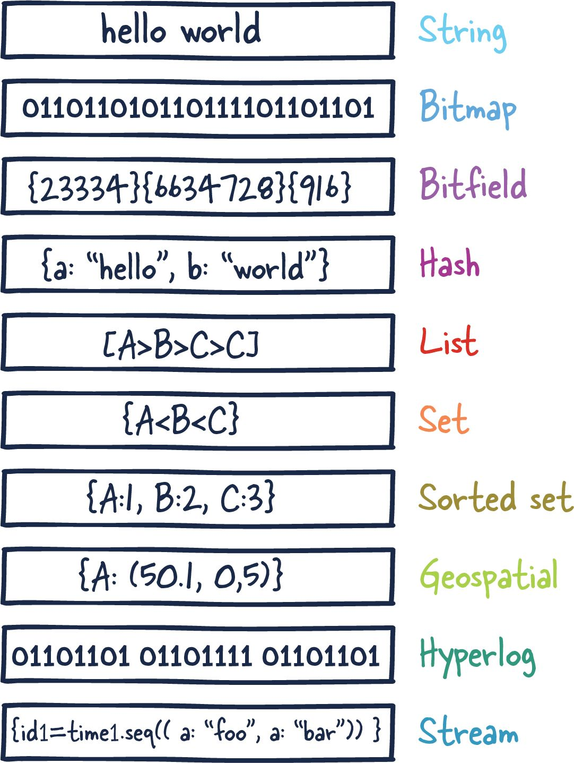
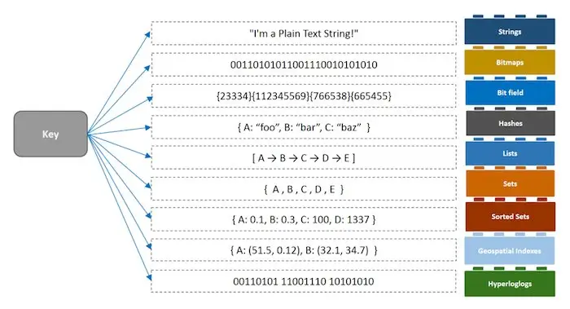
Redis Datatypes

Slide 6
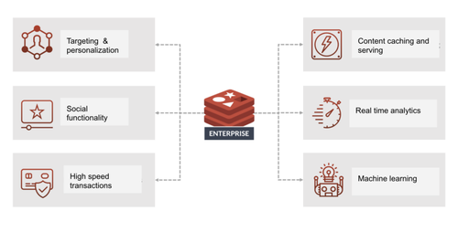
Redis Use Cases
Caching: Redis excels at caching, where it stores frequently accessed data in memory to accelerate data retrieval and reduce the load on databases.
Real-time Analytics: Redis is ideal for real-time data processing, such as counting, ranking, and maintaining leaderboards for applications that require instant insights.
Pub/Sub Messaging: Redis is a robust choice for implementing message queues and real-time messaging systems, facilitating seamless communication between components.
Session Store: Redis is widely used for managing user sessions in web applications, ensuring quick and reliable access to session data for logged-in users.

Slide 7
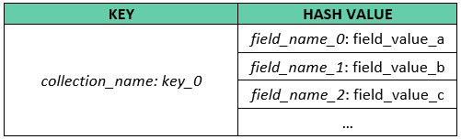
Redis for Transactions and CRUD Operations
Redis supports transactional operations (MULTI and EXEC commands) for atomicity, ensuring data consistency in complex operations.
CRUD operations (Create, Read, Update, Delete) are efficient with Redis, using commands like HSET, HGET, SADD, and DEL.
Redis's in-memory storage and speed make it ideal for real-time CRUD operations in web apps.
Optimistic locking in Redis ensures safe execution of CRUD operations in multi-user environments without data conflicts.

Slide 8
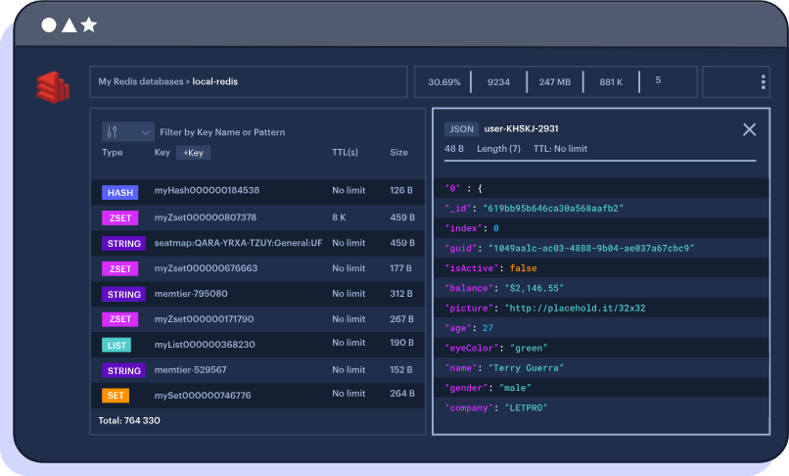
Redis GUI
What is Redis Stack ?
Redis Stack is an extended version of Redis OSS that includes additional features like JSON support, query capabilities, time series data handling, and more, providing a comprehensive platform for real-time data use cases.

Slide 9
Thank You!
Video Link: https://usfedu-my.sharepoint.com/:v:/g/personal/rishintiwari_usf_edu/EZgMelfrSZtGgxaVEFqNRMgB4yiekIU_eFbcsBVLn1x-eg?e=VswRG3

